Slide 1
Computational Geometry

Slide 2
Computational Geometry
A branch of algorithmics dealing with computation on geometric objects
Algorithmics is the branch of computer science that consists of designing and analyzing computer algorithms
It Involves
its description at an abstract level using a pseudo-language, and
the proof that the algorithm is correct
Analysis deals with evaluating the performance of an algorithm; for example, its cost in time, a task called complexity analysis
An algorithm is a sequence of operations performed on data that have to be organized in data structures.
A careful design of data structures is required for optimizing the operations for a given algorithm

Slide 3
Basic Concepts of Algorithms
3 Cornerstones of algorithm
the model of computation
the language used for describing the algorithm
the performance evaluation
The algorithm is an abstraction of a program to be executed on a physical machine
An abstraction, or model of computation, allows one to describe what type of information a machine can handle, as well as the operations available.
Once the model of computation has been defined, an algorithm can be described using the primitive operations
The performance evaluation of an algorithm is obtained by totaling the number of occurrences of each operation when running the algorithm
For the sake of simplicity and ease of expression, one gets rid of unnecessary details in the computation
Algorithm evaluation is a function f (n,c1,c2,...,cm), whose arguments are (1) the size n of the input and (2) the cost ci of each key operation

Slide 4
Basic Concepts of Algorithms
The focus is on the dependence of computation time on input size rather than on the cost of each operation, which is implementation and machine dependent.
Upper bound
A function g(n) of the input size is said to be O(f (n)) if there exist a constant C and an integer n0 such that g(n) ≤ Cf (n) for all n > n0.
Lower bound
A function g(n) is said to be Ώf (n)) if there exist C and n0 such that g(n) ≥ Cf (n) for all n > n0.
Same order
A function g(n) is said to be Θ(f (n)) if there exist C1, C2, and n0 such that C1f (n) ≤ g(n) ≤ C2f (n) for all n > n0.

Slide 5
Algorithm Analysis
The complexity of an algorithm is a function g(n) that gives the upper bound of the number of operations performed by an algorithm when the input size is n.
The number of operations is also called algorithm “running time.”
Worst-case complexity
In this case, the running time for any input of a given size will be lower than the upper bound, except possibly for some values of the input where the maximum is reached.
Average-case complexity.
In this case, g(n) is the average number of operations over all problem instances for a given size.
The average-case complexity is more representative of the actual behavior of an algorithm.
Unfortunately, it is quite difficult to estimate, as the statistical behavior of the input is not easily predictable
Most of the analyses give, therefore, a worst-case complexity.
Notes:
It is important to keep in mind that the practical behavior of an algorithm may turn out to be better than the value estimated from a worst-case analysis.
Most of the time, the complexity g(n) is approximated by its family O(f (n)), where f (n) is one of the following functions: n (linear complexity), log n (logarithmic complexity), na , a ≥ 2 (polynomial complexity), an (exponential complexity). An algorithm whose complexity is linear (logarithmic, and so on) with the input size is referred to as a linear algorithm.

Slide 6
Algorithm Analysis
Even though this approximation provides a useful classification of algorithms, it leads to a loose estimate of the actual complexity because it does not take into account the multiplicative constant C and the fact that the complexity is true for n > n0.
Thus, two algorithms with the same asymptotic complexity may lead to quite different computation times
Notes:
It is important to keep in mind that the practical behavior of an algorithm may turn out to be better than the value estimated from a worst-case analysis.
Most of the time, the complexity g(n) is approximated by its family O(f (n)), where f (n) is one of the following functions: n (linear complexity), log n (logarithmic complexity), na , a ≥ 2 (polynomial complexity), an (exponential complexity). An algorithm whose complexity is linear (logarithmic, and so on) with the input size is referred to as a linear algorithm.

Slide 7
Optimality
An algorithm for a given problem is optimal if its complexity reaches the lower bound over all the algorithms solving this problem
estimating a lower bound is an essential task, and unfortunately a difficult one

Slide 8
USEFUL ALGORITHMIC STRATEGIES
Incremental Algorithms: The Convex-Hull Example
An incremental algorithm uses a straightforward strategy that works as follows.
The idea is to first take a subset of the input small enough so that the problem is easily solved, and then to add, one by one, the remaining elements of the input while maintaining the solution at each step.

Slide 9
Divide-and-Conquer Strategy: The Half-Plane Intersection Example
The divide-and-conquer strategy has for a long time proved effective in many situations.
It relies on a recursive approach and has two steps.
In the first step (top-down), the input is recursively divided until the subproblems are small enough in size to be solved easily.
The second step (bottom-up) consists of recursively merging the solutions.
This strategy is also used in sorting algorithms such as merge-sort and quicksort.
Building the structure
The set of n half-planes in the input is recursively halved until one obtains n singleton half-planes. This yields a binary tree
Solving an atomic problem.
The half-plane in each leaf singleton is intersected with rectangle R. This yields a convex polygon in each leaf.
Merging the results.
Compute recursively the intersection of the convex polygons (going up in the structure defined in the first item in this list.)

Slide 10
Sweep-Line Method: The Rectangle Intersection Example
The sweep-line (or plane-sweep) technique is intensively used in computational geometry.
It consists of decomposing the geometric input into vertical strips, such that the information relevant to the problem is located on the vertical lines that separate two strips.
Therefore, by “sweeping” a vertical line from left to right, stopping at the strip boundaries, we can maintain and update the information needed for solving a given problem.
A structure called the state of the sweep or sweep-line active list, denoted in the following L. This structure is updated as the line goes through a finite number of positions, called events.
A structure called event list and denoted in the following ε, which can be known beforehand or discovered step-by-step as the sweep goes on.
In the first case, a chained list is used to store the information, whereas in the second case, another structure that supports searching, inserting, and possibly deleting is necessary (e.g., a priority queue).

Slide 11
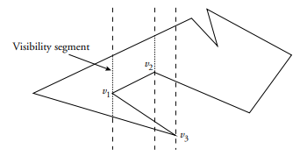
POLYGON PARTITIONING
Polygon decomposition, an important issue of computational geometry, is central to spatial databases because polygons are the most complex objects to be dealt with in 2D applications.
Then, partitioning a polygon in simpler elements often simplifies algorithm design and implementation.
Trapezoidalization of a Simple Polygon
A trapezoid is a quadrilateral with at least two parallel edges.
A triangle can be viewed as a degenerated trapezoid with a
null-length edge.
The trapezoidalization algorithm relies on the sweep-line technique.
First, the vertices of polygon P are sorted according to their x coordinate.
Then a vertical line l scans the sorted vertices.
For each vertex v, we compute the maximal vertical segment on l , internal to P and containing v

Slide 12
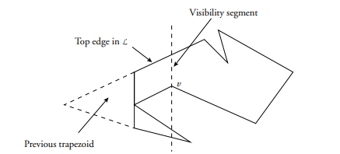
POLYGON PARTITIONING
The visibility segments define the trapezoidalization.
The polygon is decomposed into trapezoids with vertical parallel edges (visibility segments)

Slide 13
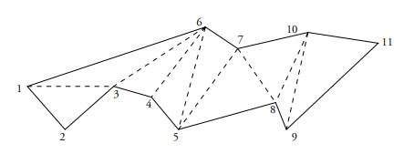
Triangulation of Simple Polygons
Triangulating a polygon P from scratch consists of finding diagonals within this polygon.
A diagonal is a segment ViVj between two vertices of P whose interior does not intersect the boundary of P. Vi and Vj are said to be visible from each other.
The triangulation is not deterministic, but one can show that every triangulation of a polygon P of n vertices has n − 3 diagonals and results in n − 2 triangles.
Algorithms that directly triangulate a simple polygon but they are rather slow.
Monotone polygons can be linearly triangulated, and thus that partitioning a simple polygon into monotone polygons is the key to efficient triangulation algorithms.

Slide 14
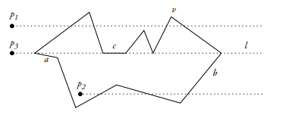
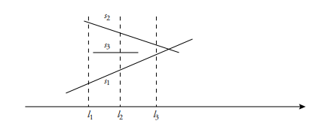
ALGORITHMS FOR SPATIAL DATABASES
Area Size of a Polygon and Related Operations
Point in Polygon
Polyline Intersections
Point in Polygon

